Slide 1
Sales Insights Data Analysis Project
File created on: 21-03-2022 16:23:15

Slide 2
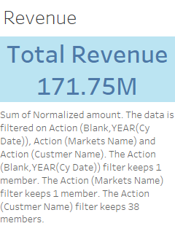

Slide 3
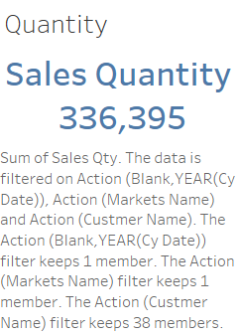

Slide 4
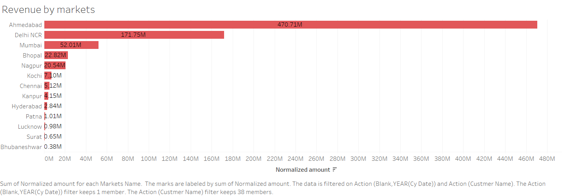

Slide 5


Slide 6


Slide 7


Slide 8
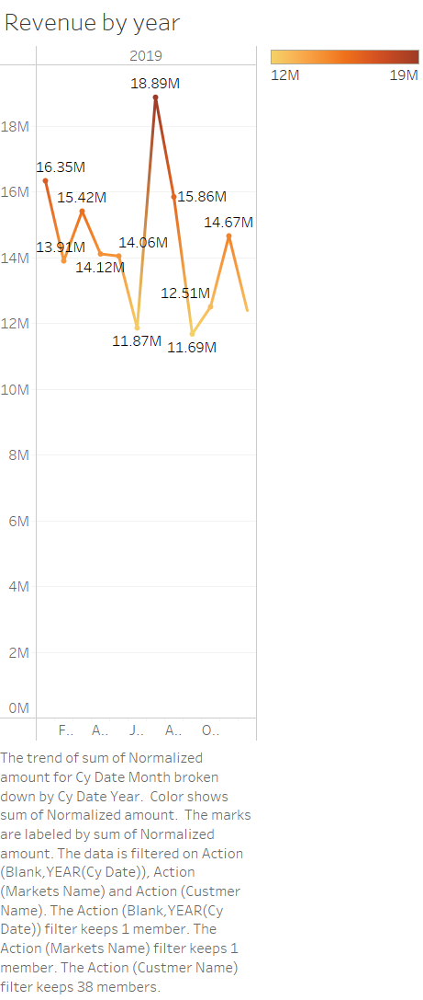

Slide 9
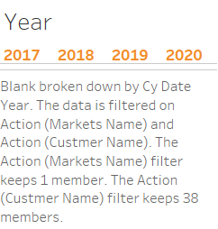

Slide 10


Slide 11
